Slide 1
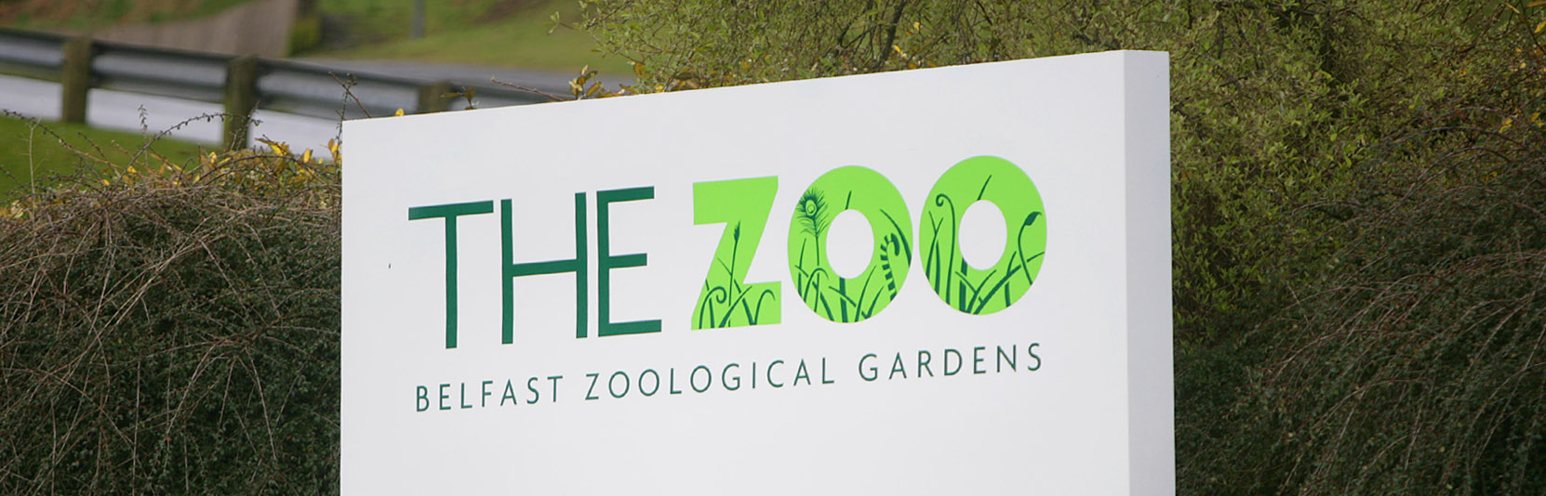
We are going on a trip to Belfast zoo with school

Slide 2
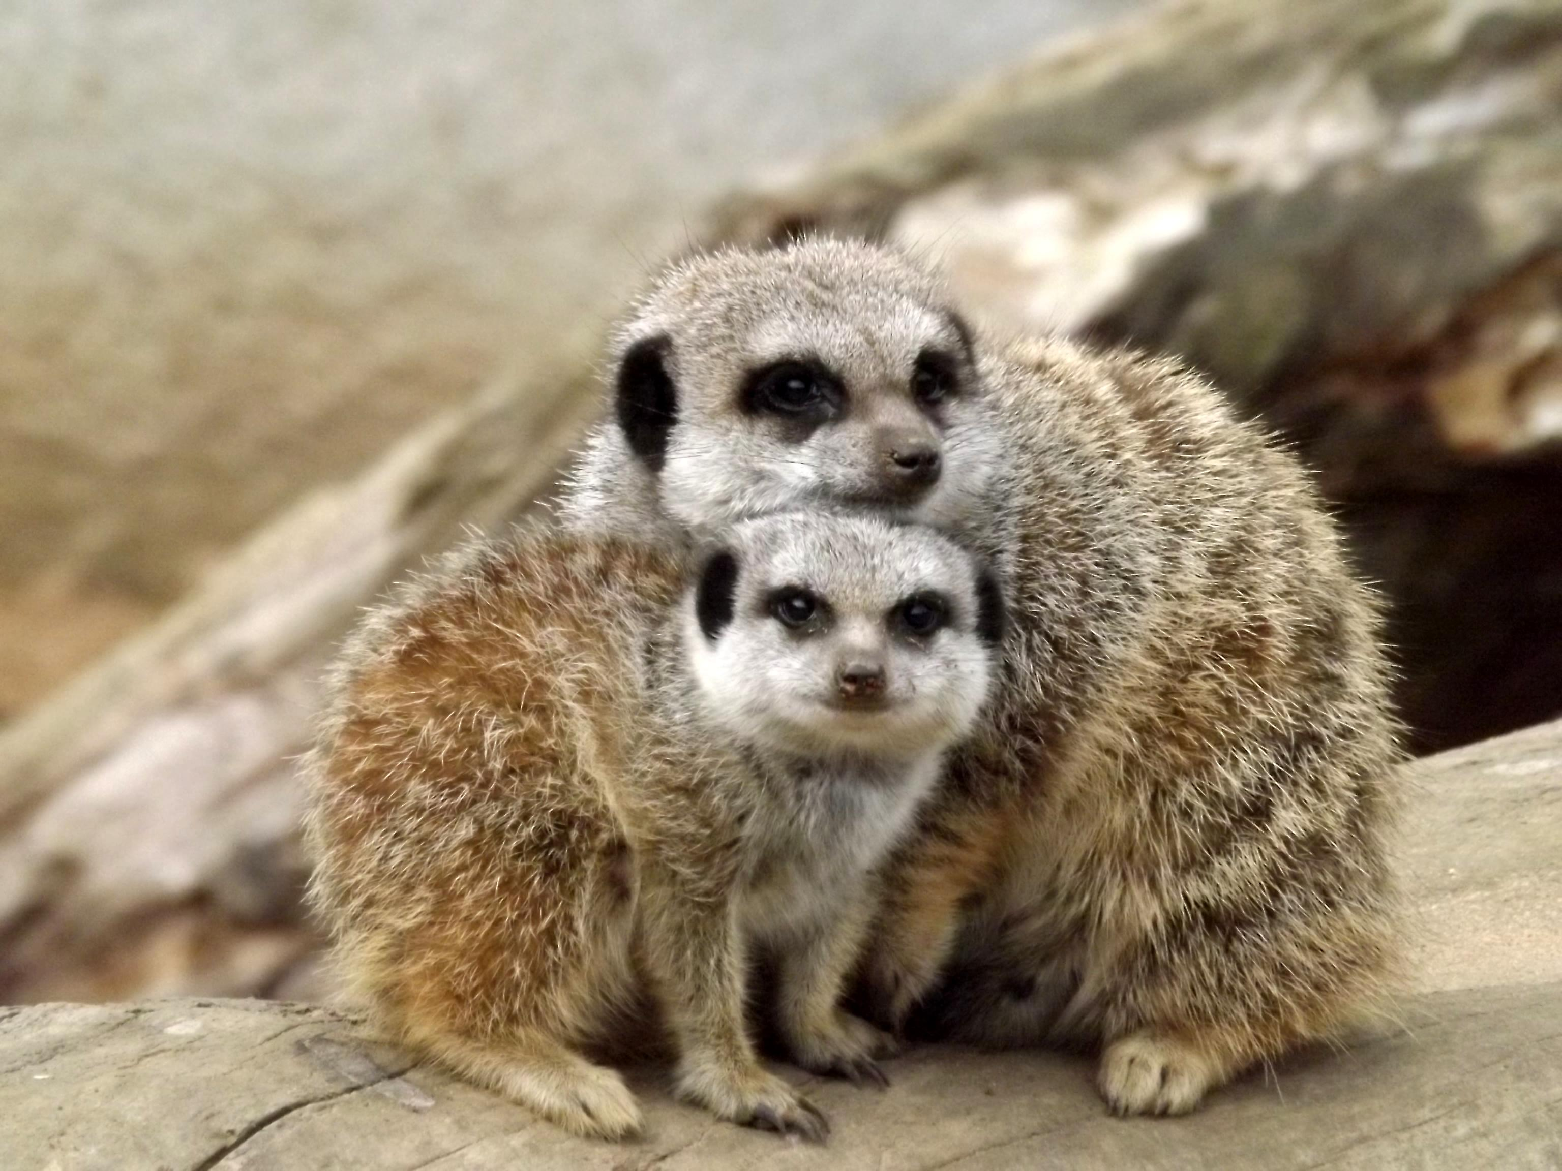
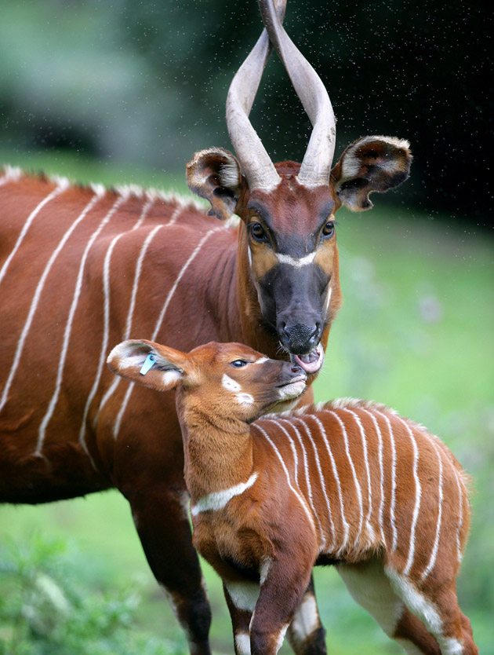
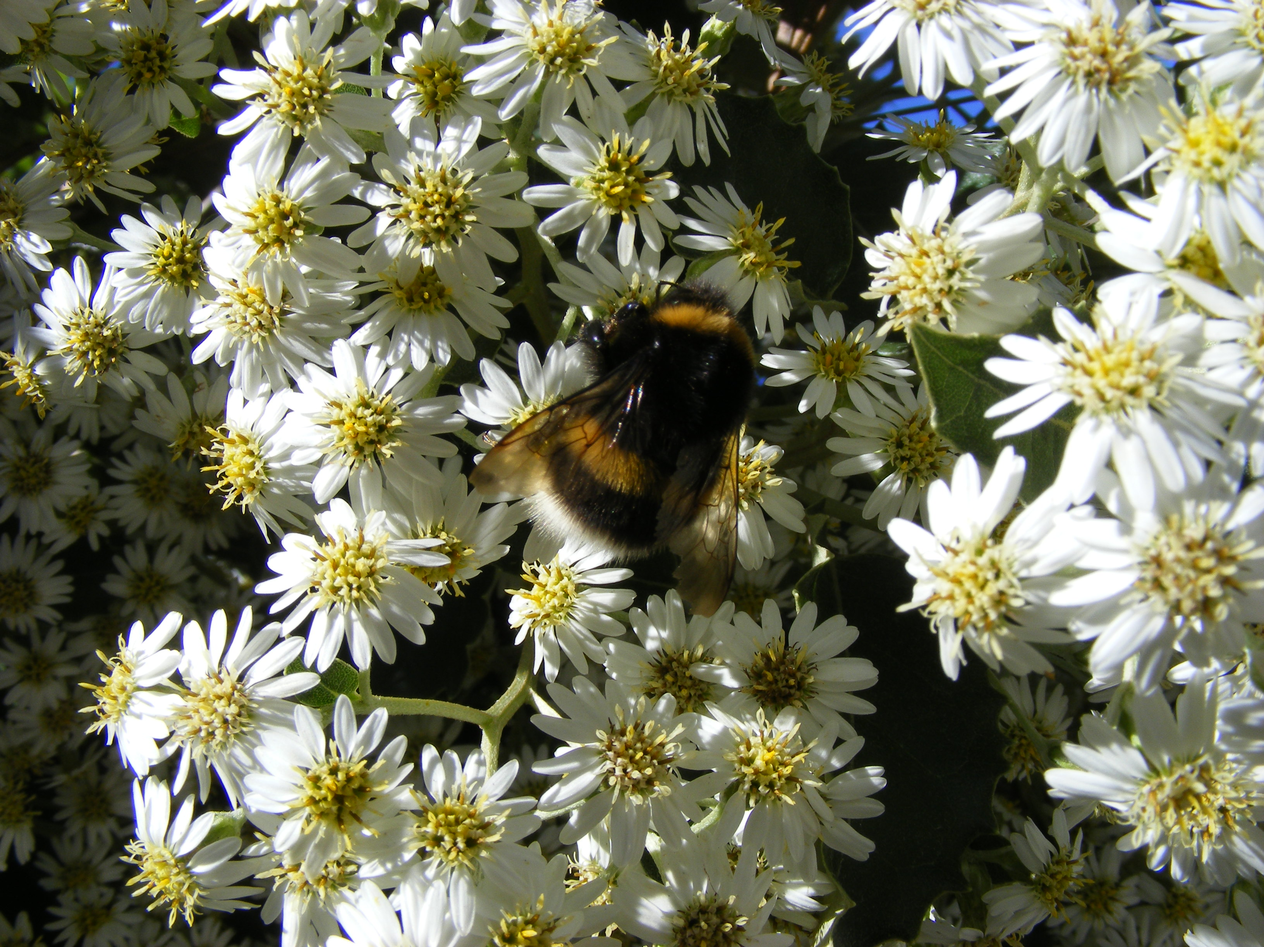
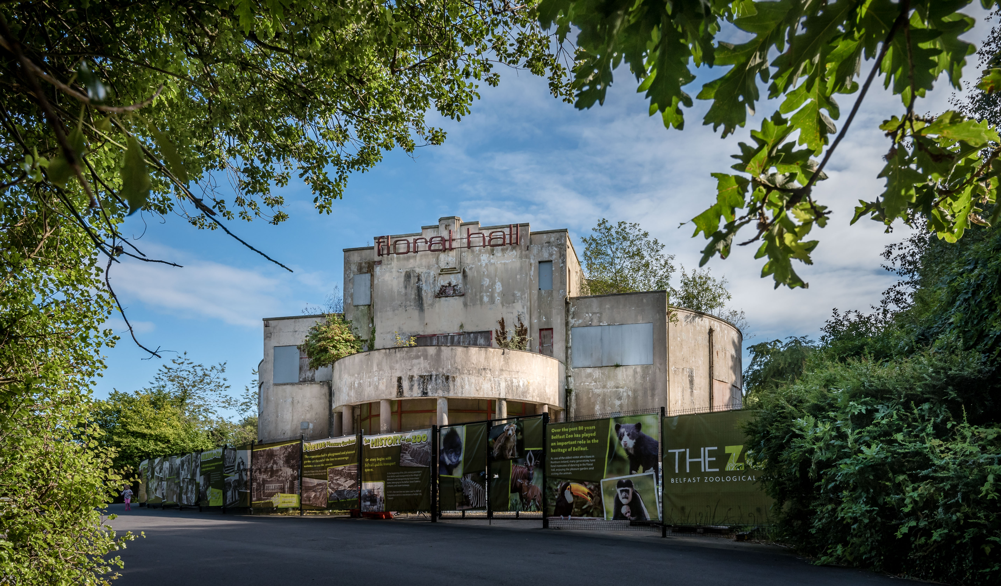
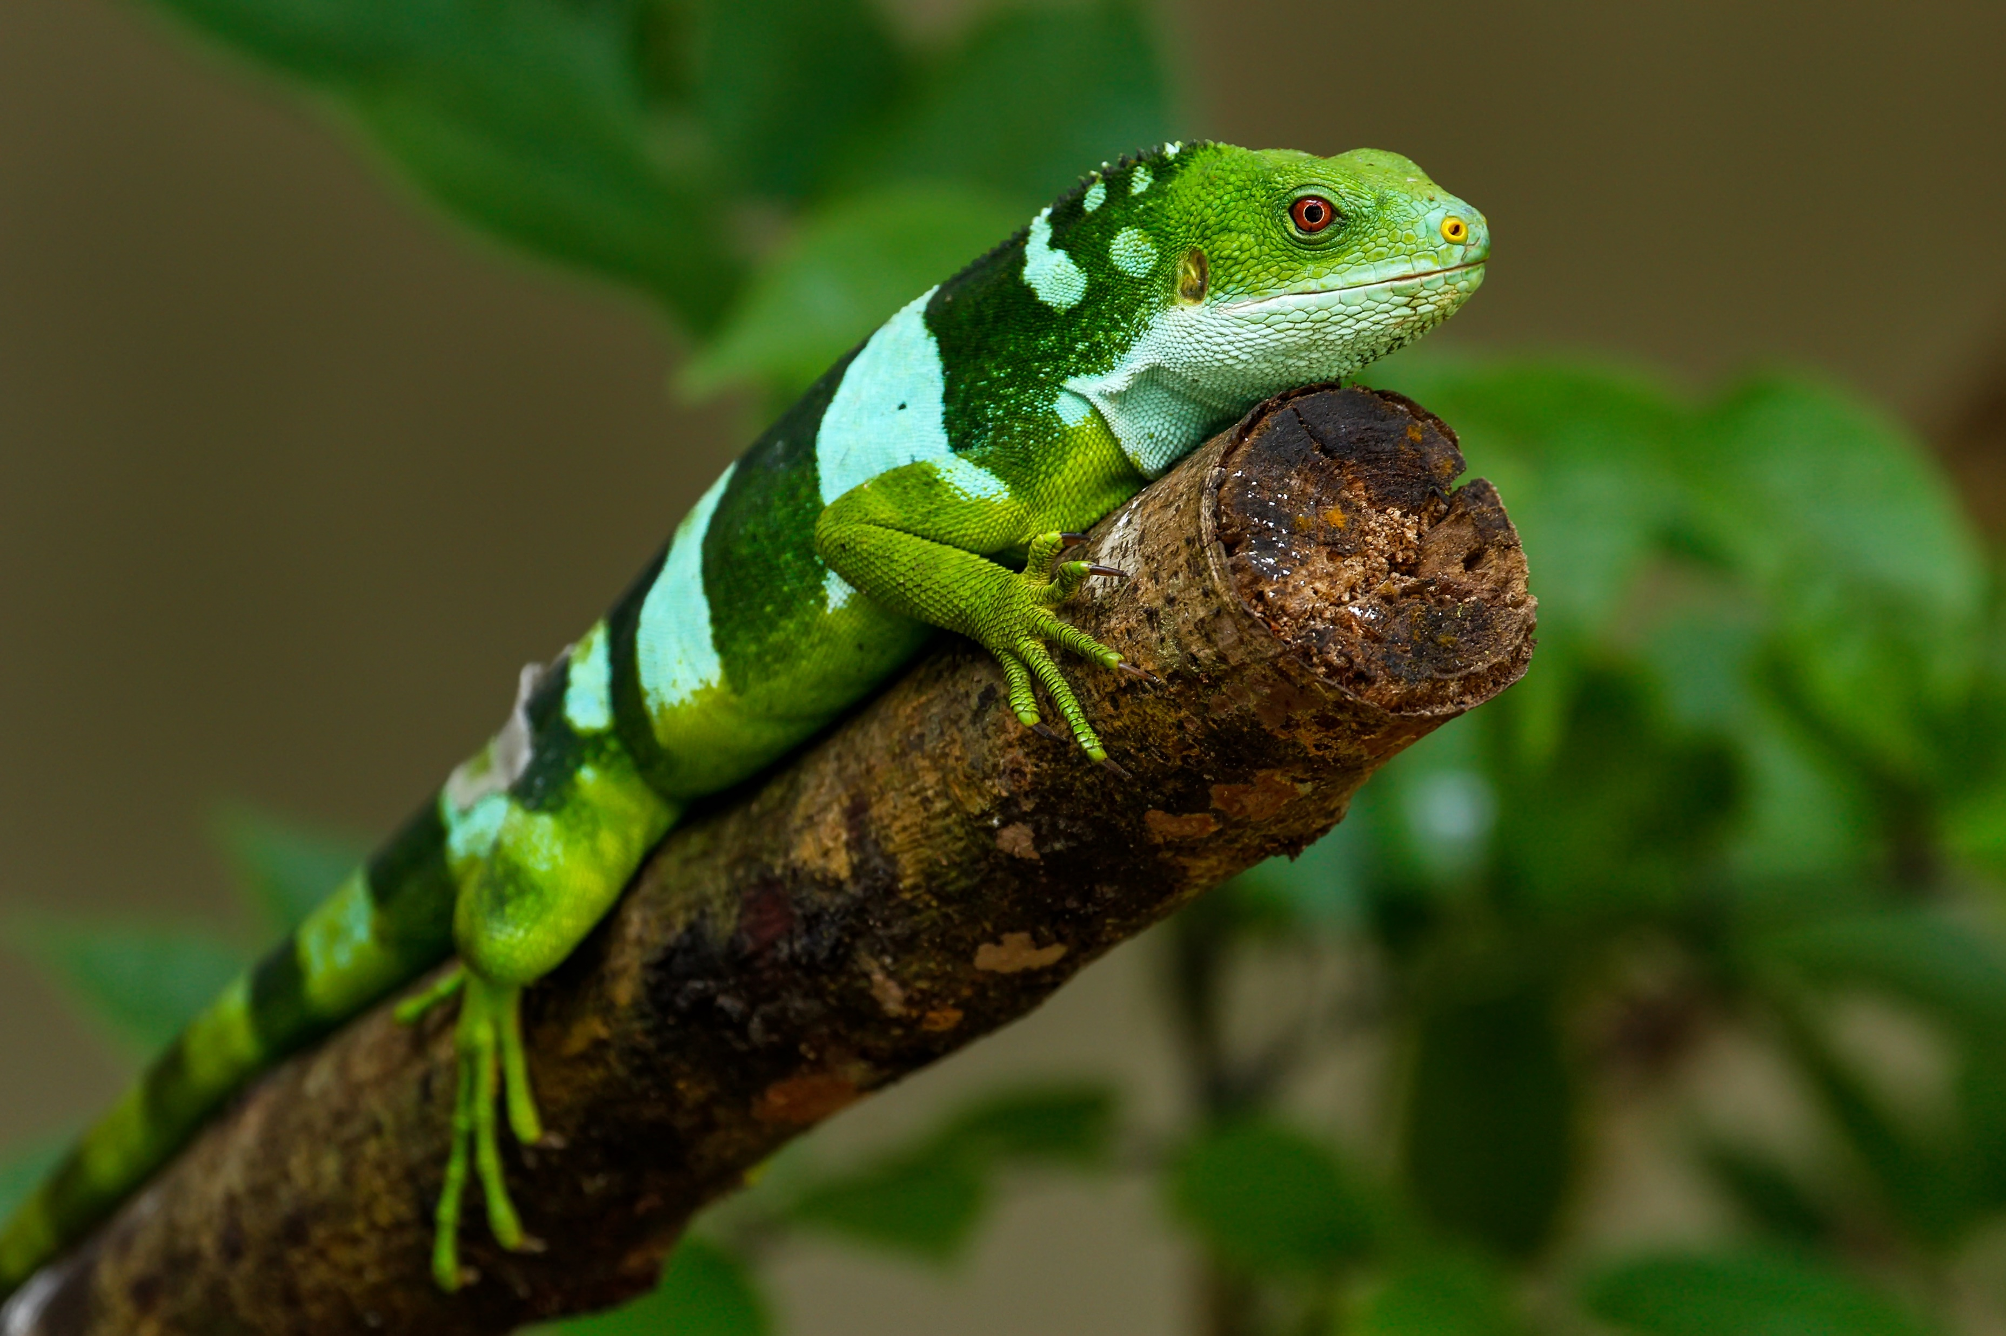
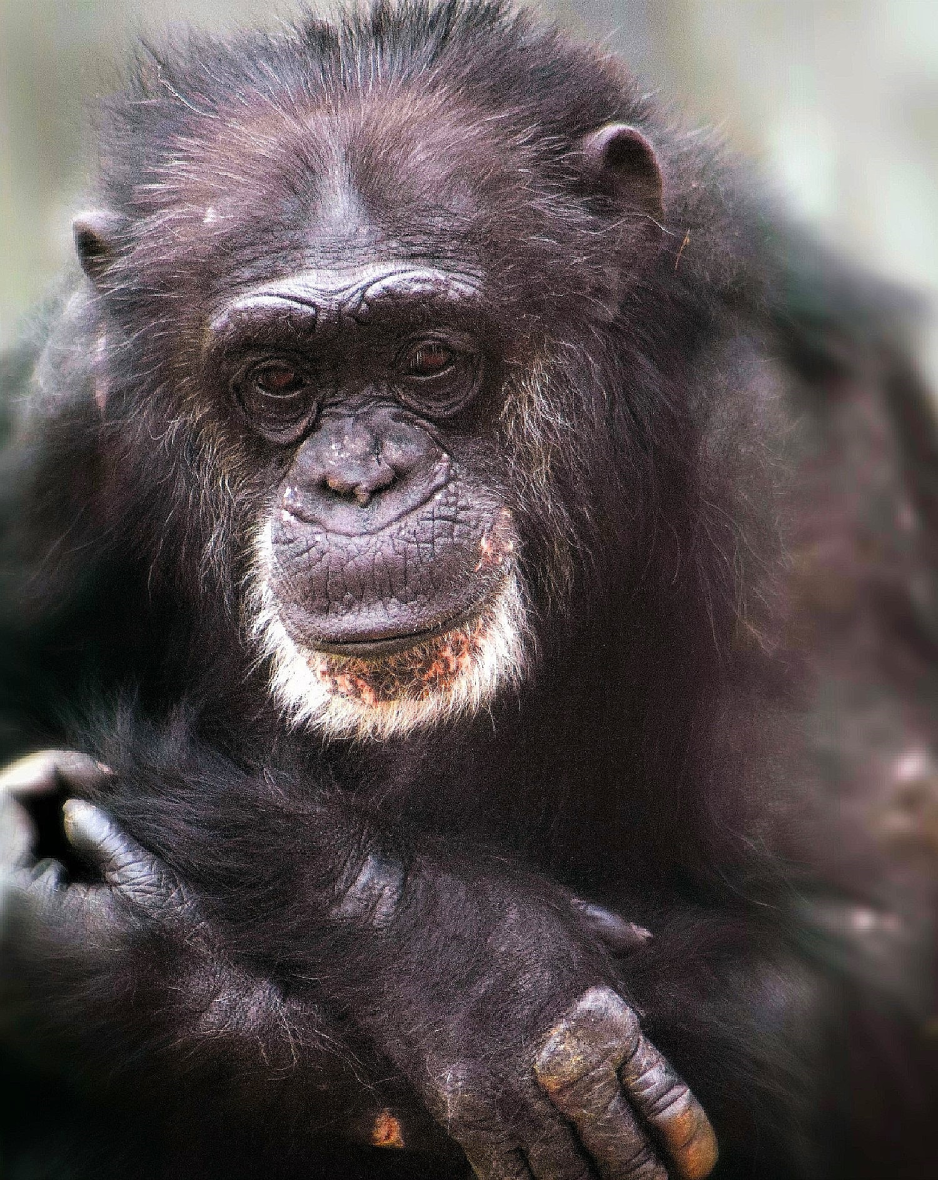
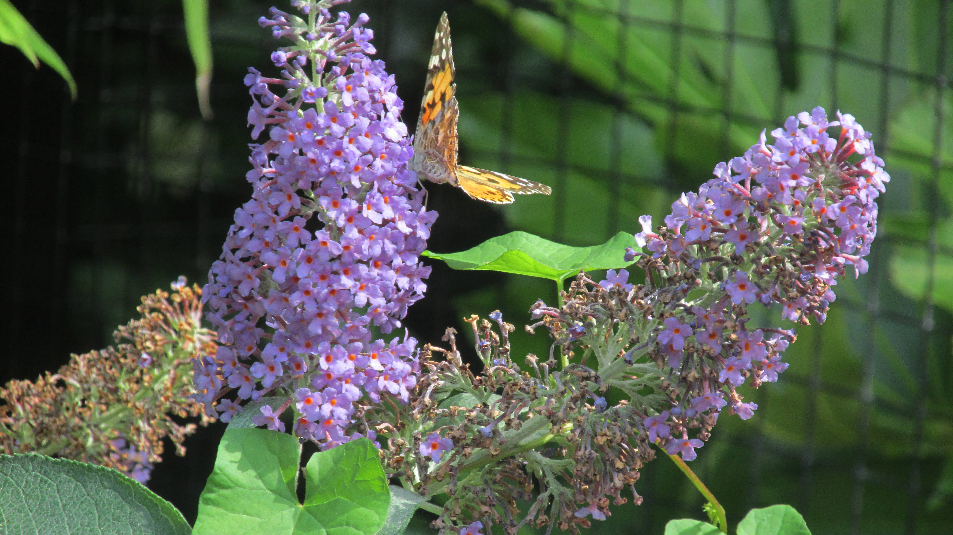
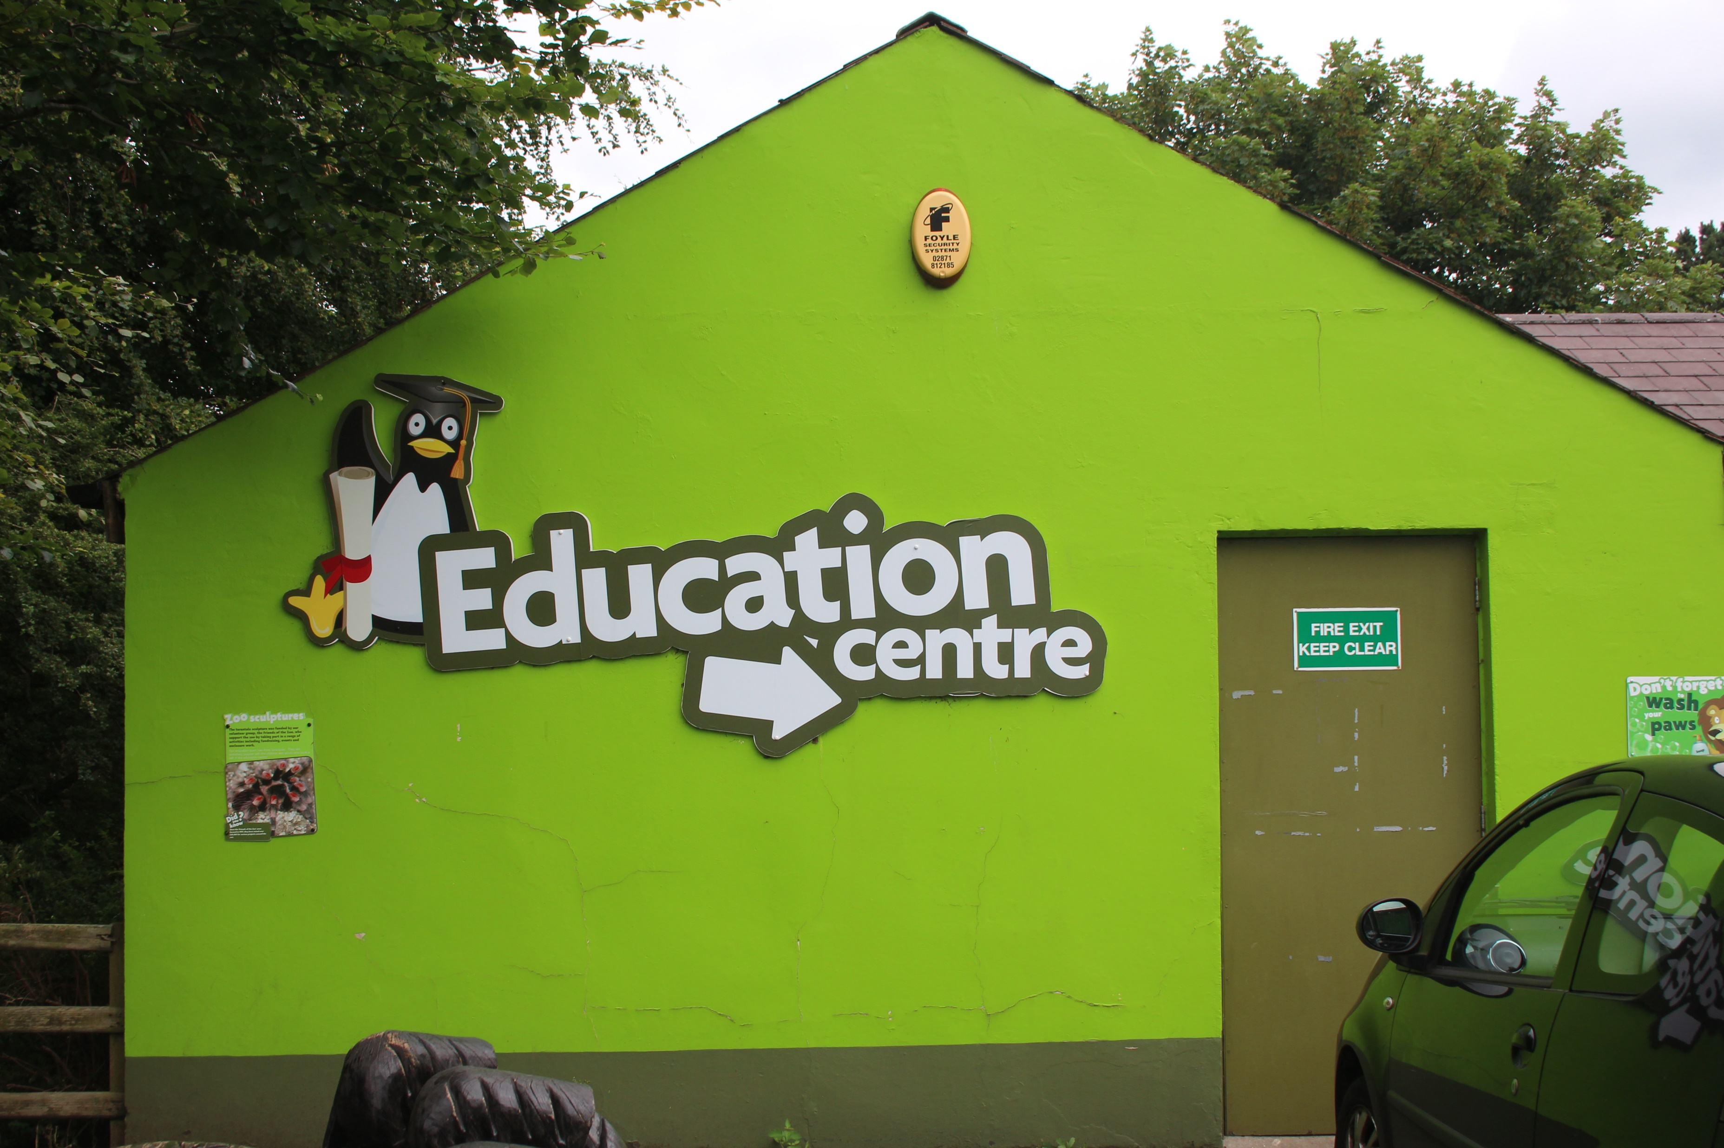
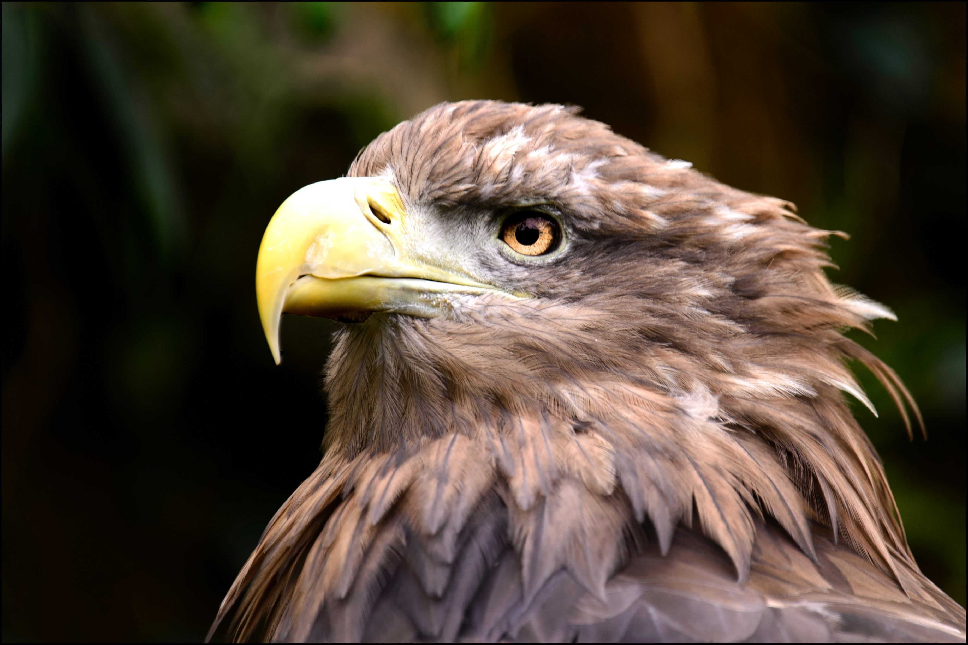
At the zoo we will see lots of different animals, plants, buildings and people.

Slide 3
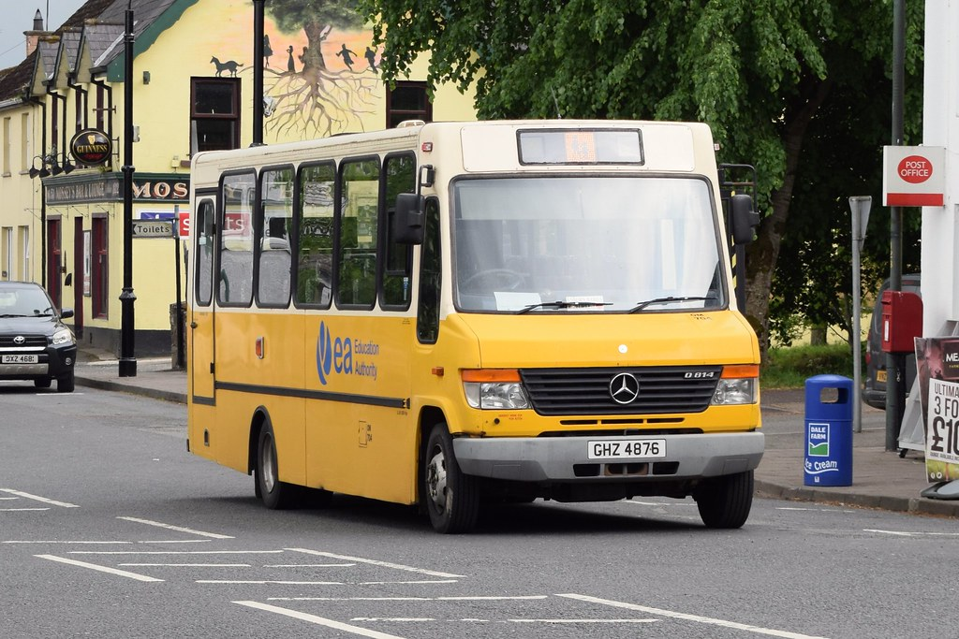
First, we will get on the bus at school with our teacher and classmates.

Slide 4
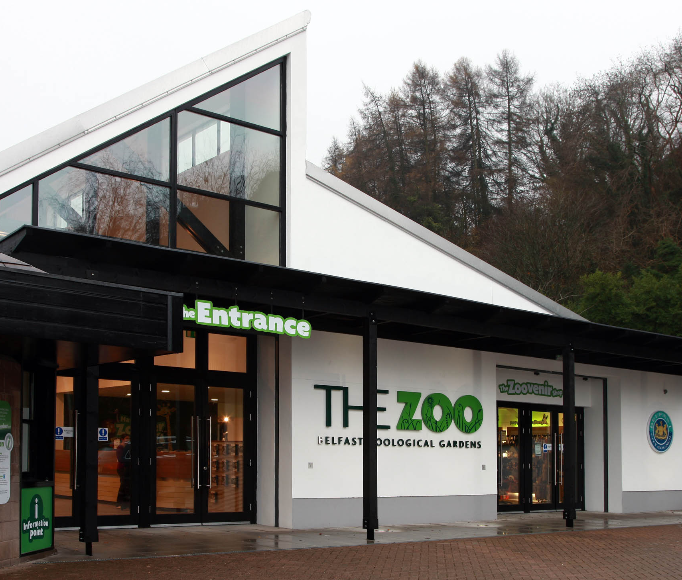
The bus will go up a hill and bring us to the doors of Belfast zoo

Slide 5
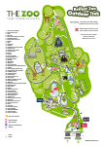
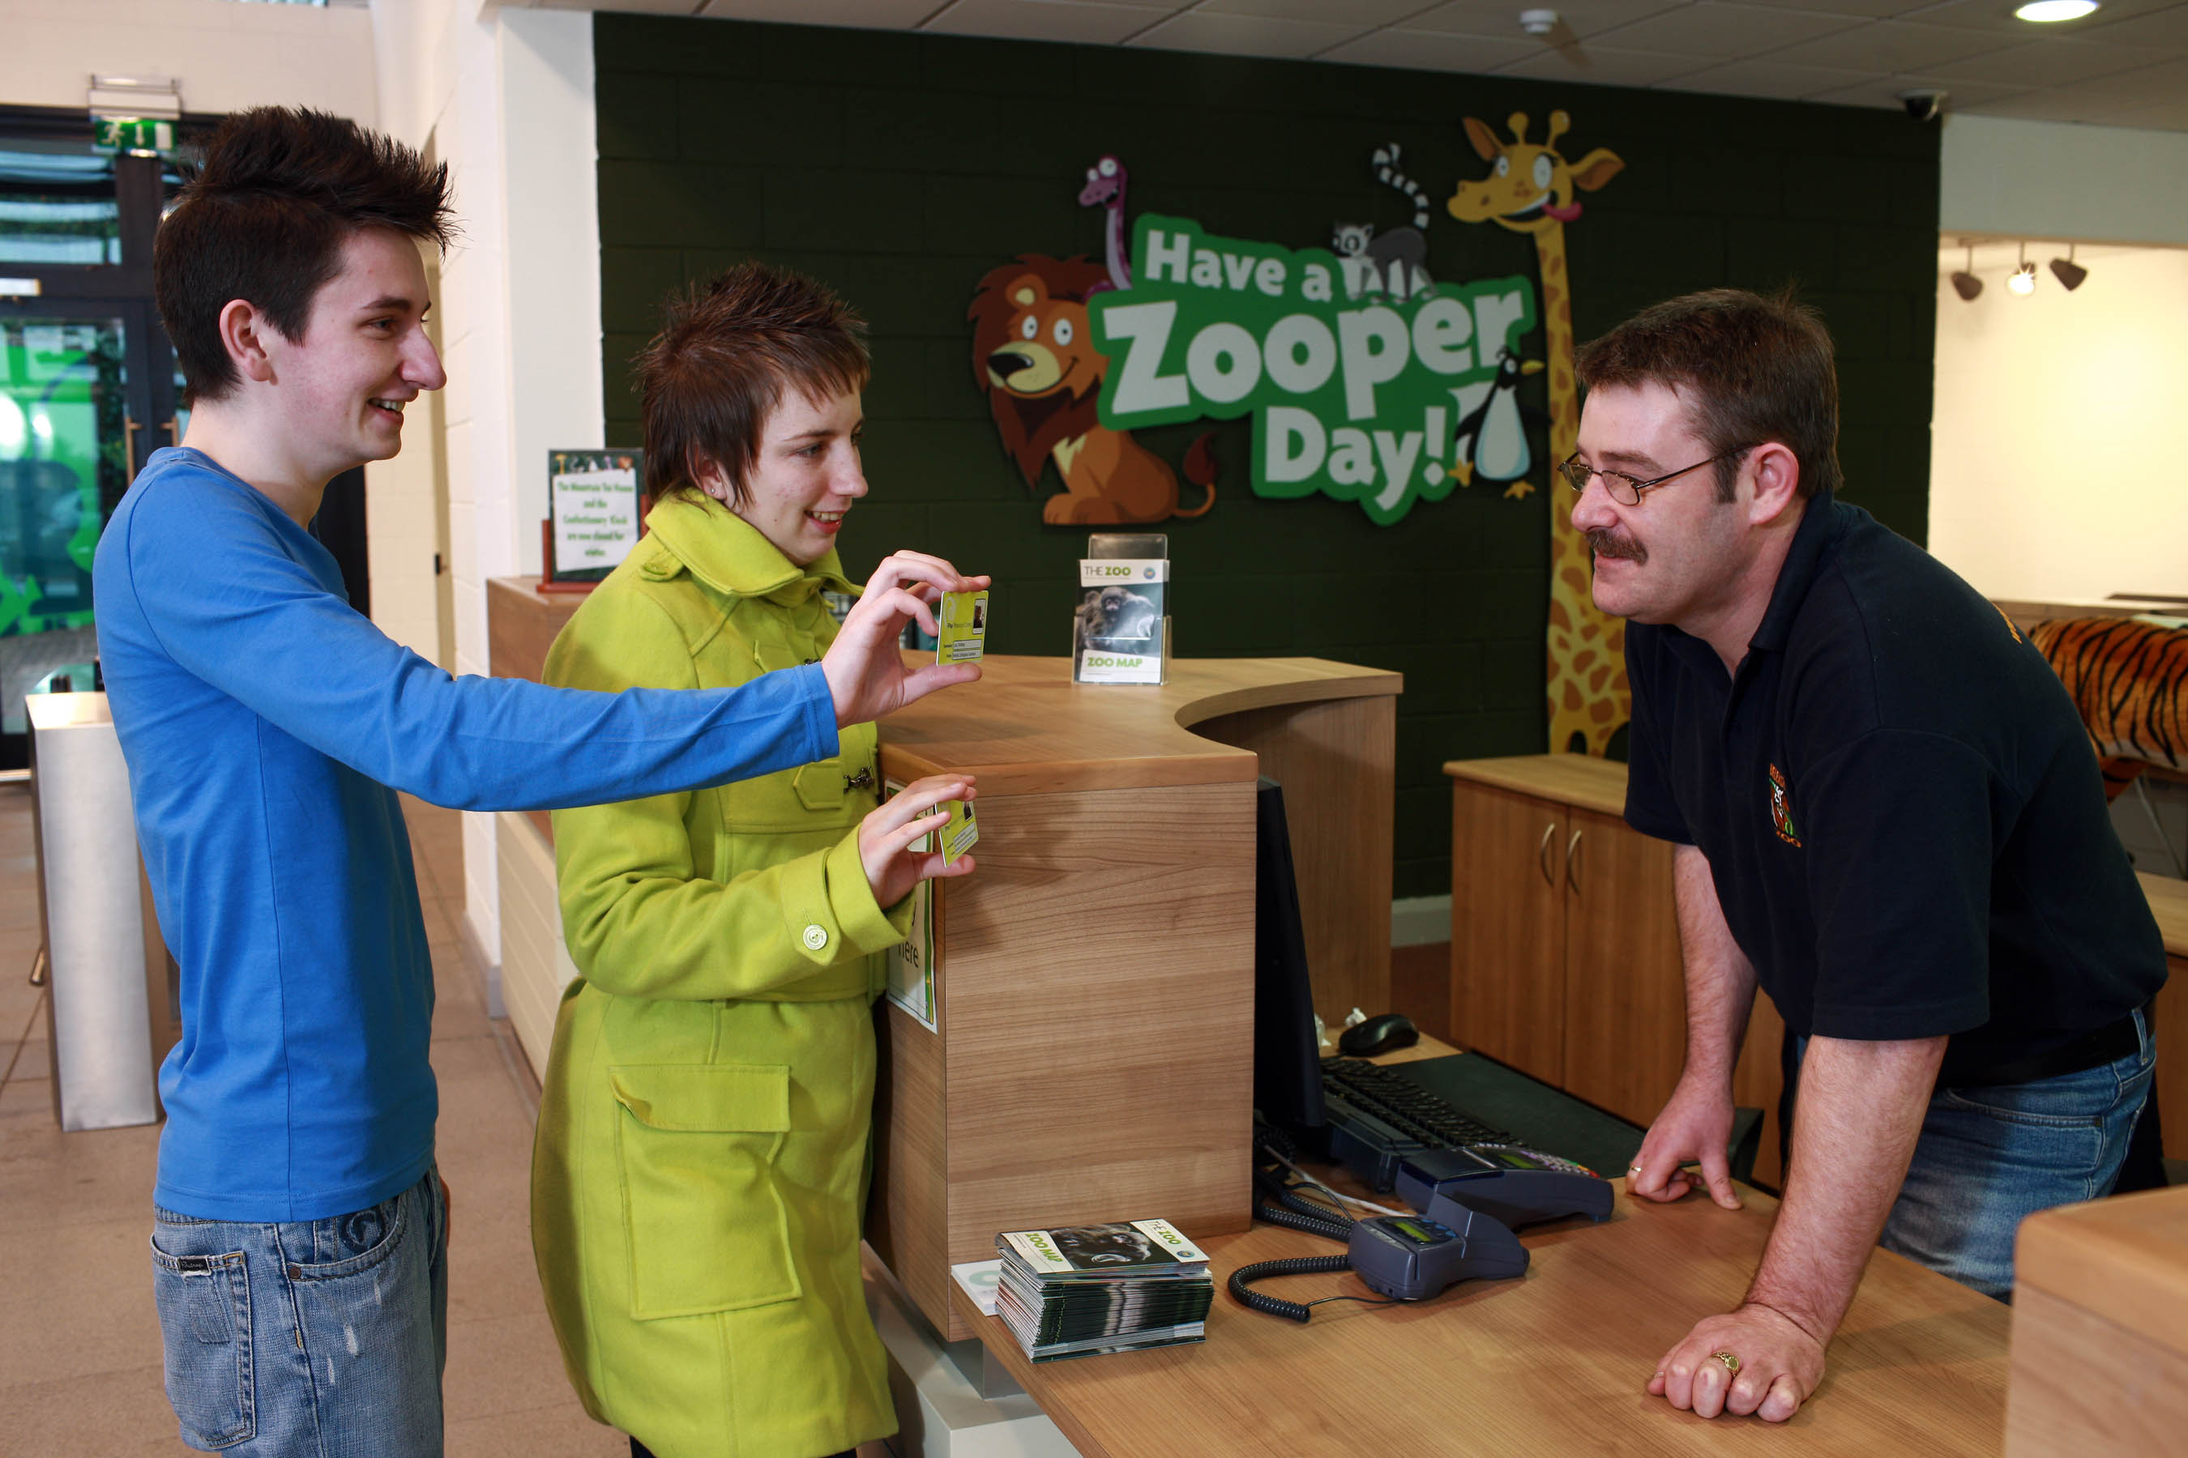
We will go to the Lady/Man at reception to pay and wait with our teacher and classmates here. The lady/Man will also give us a map of the zoo

Slide 6
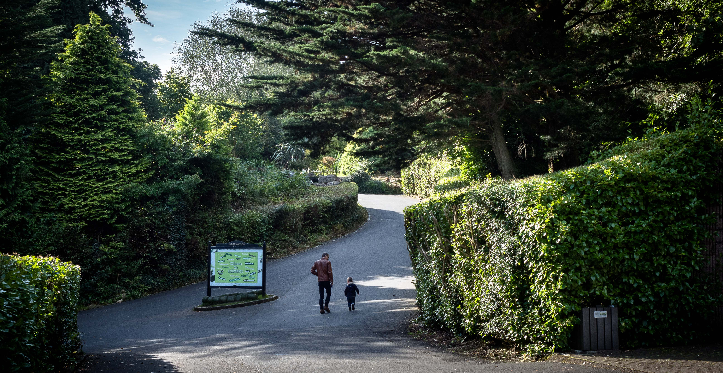
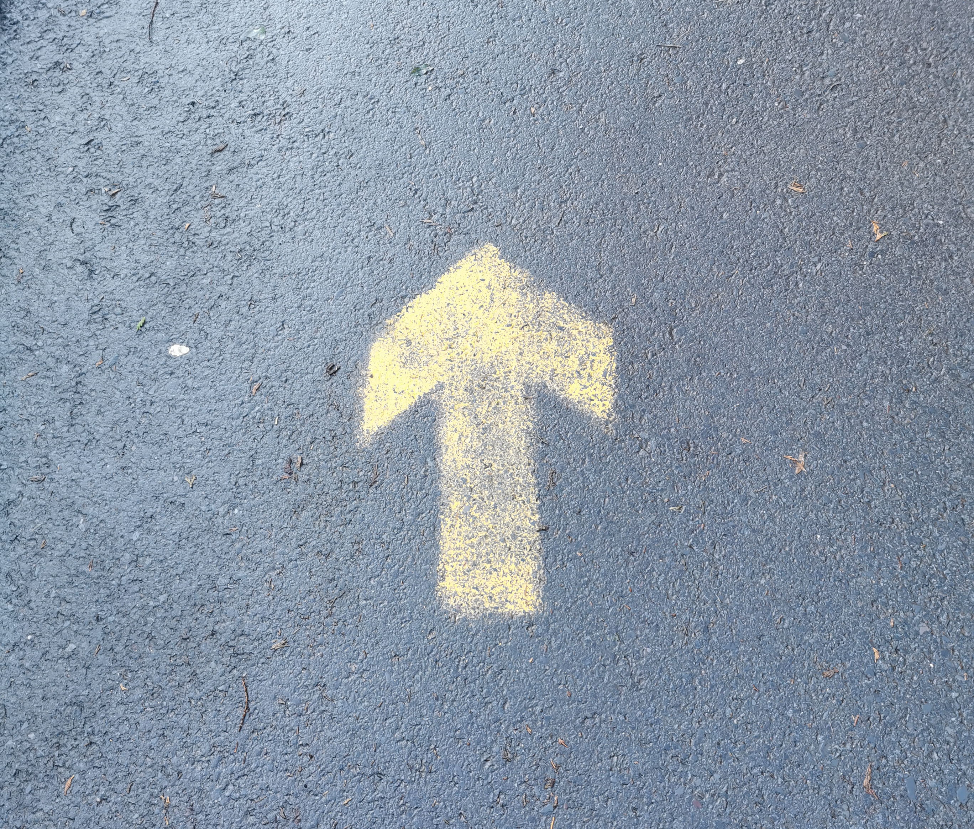
Then we follow the arrows up the big hill and will walk pass Floral hall

Slide 7

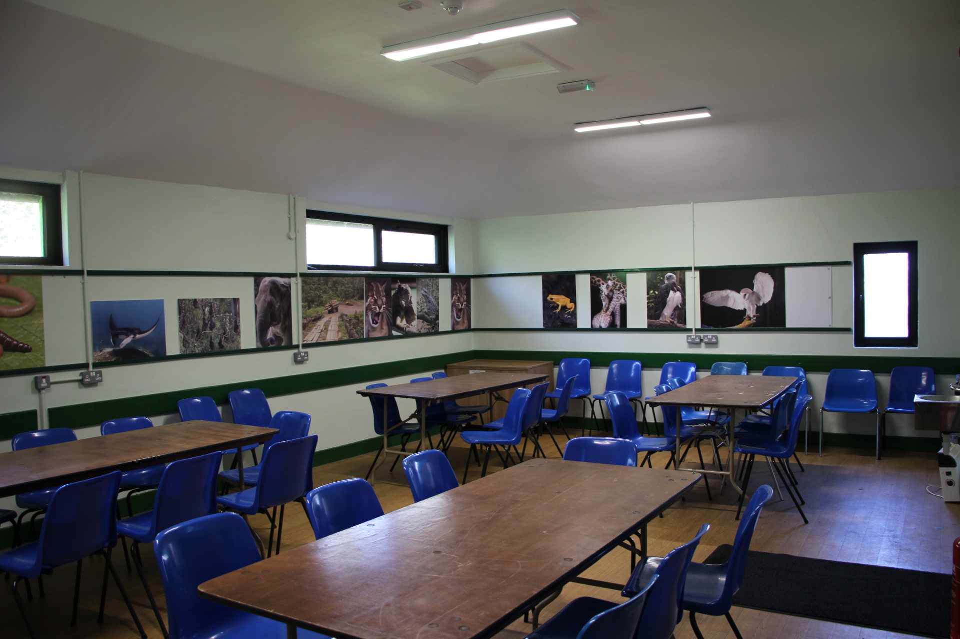
This will bring us to education centre, where we will meet the education officer who will teach us all about animals.

Slide 8
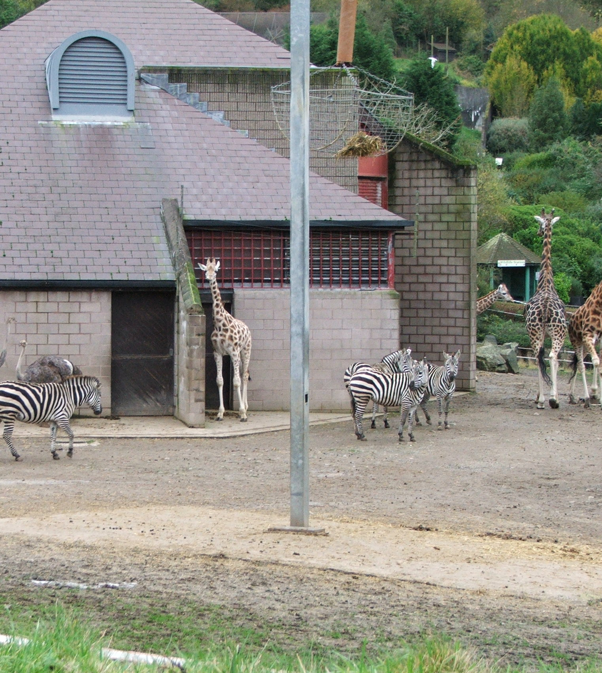
After the lesson is over, we get to explore the zoo with our teacher and classmates

Slide 9
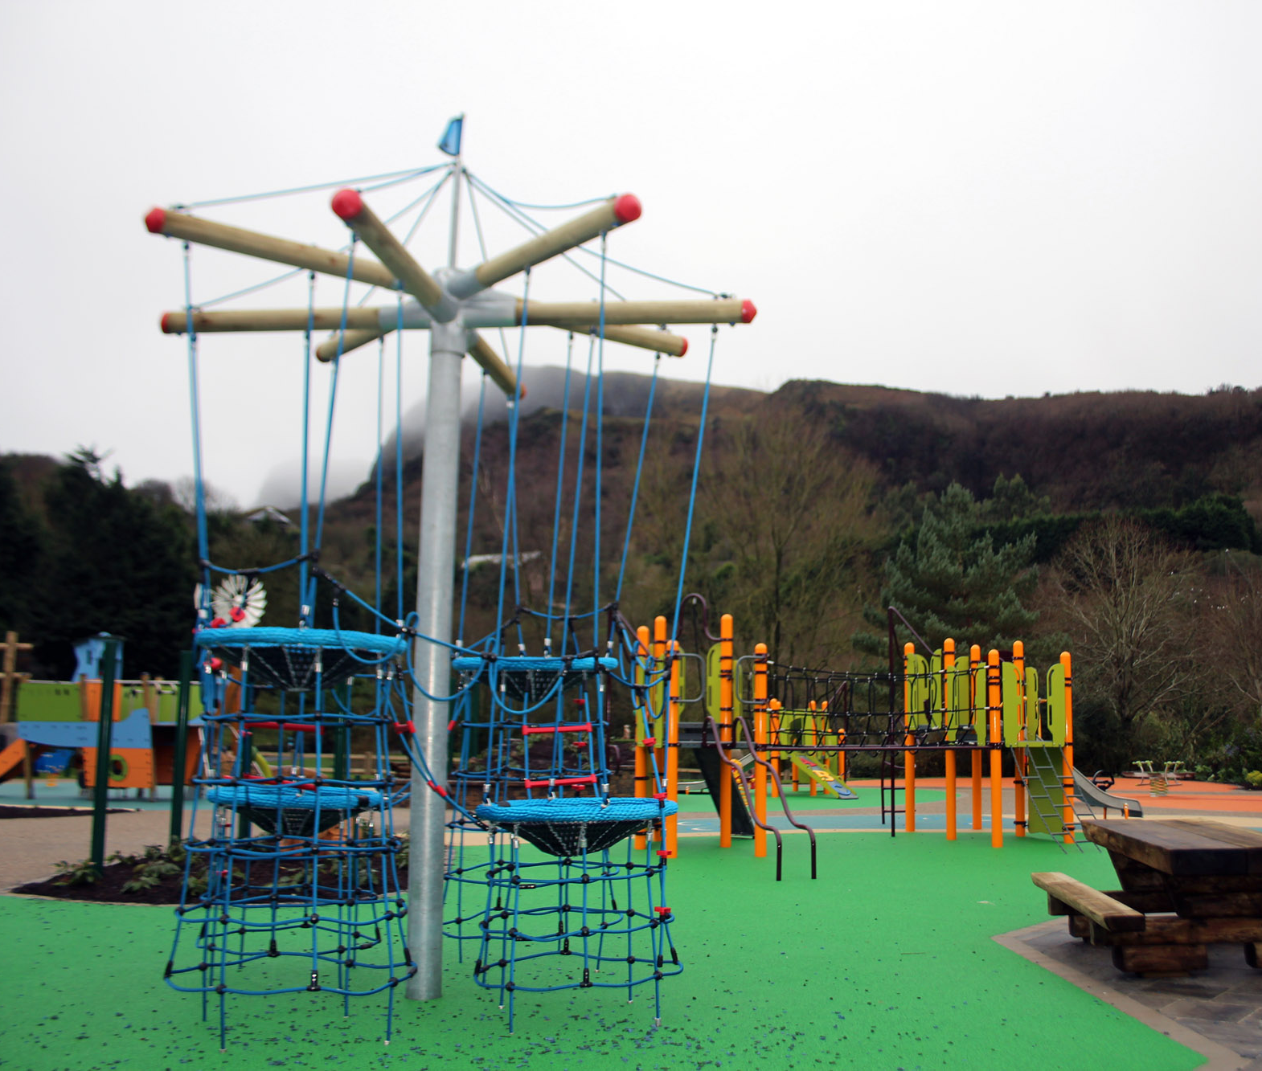
Beside the pond with the flamingos and ducks there is a big play park where we can have snack and play.

Slide 10
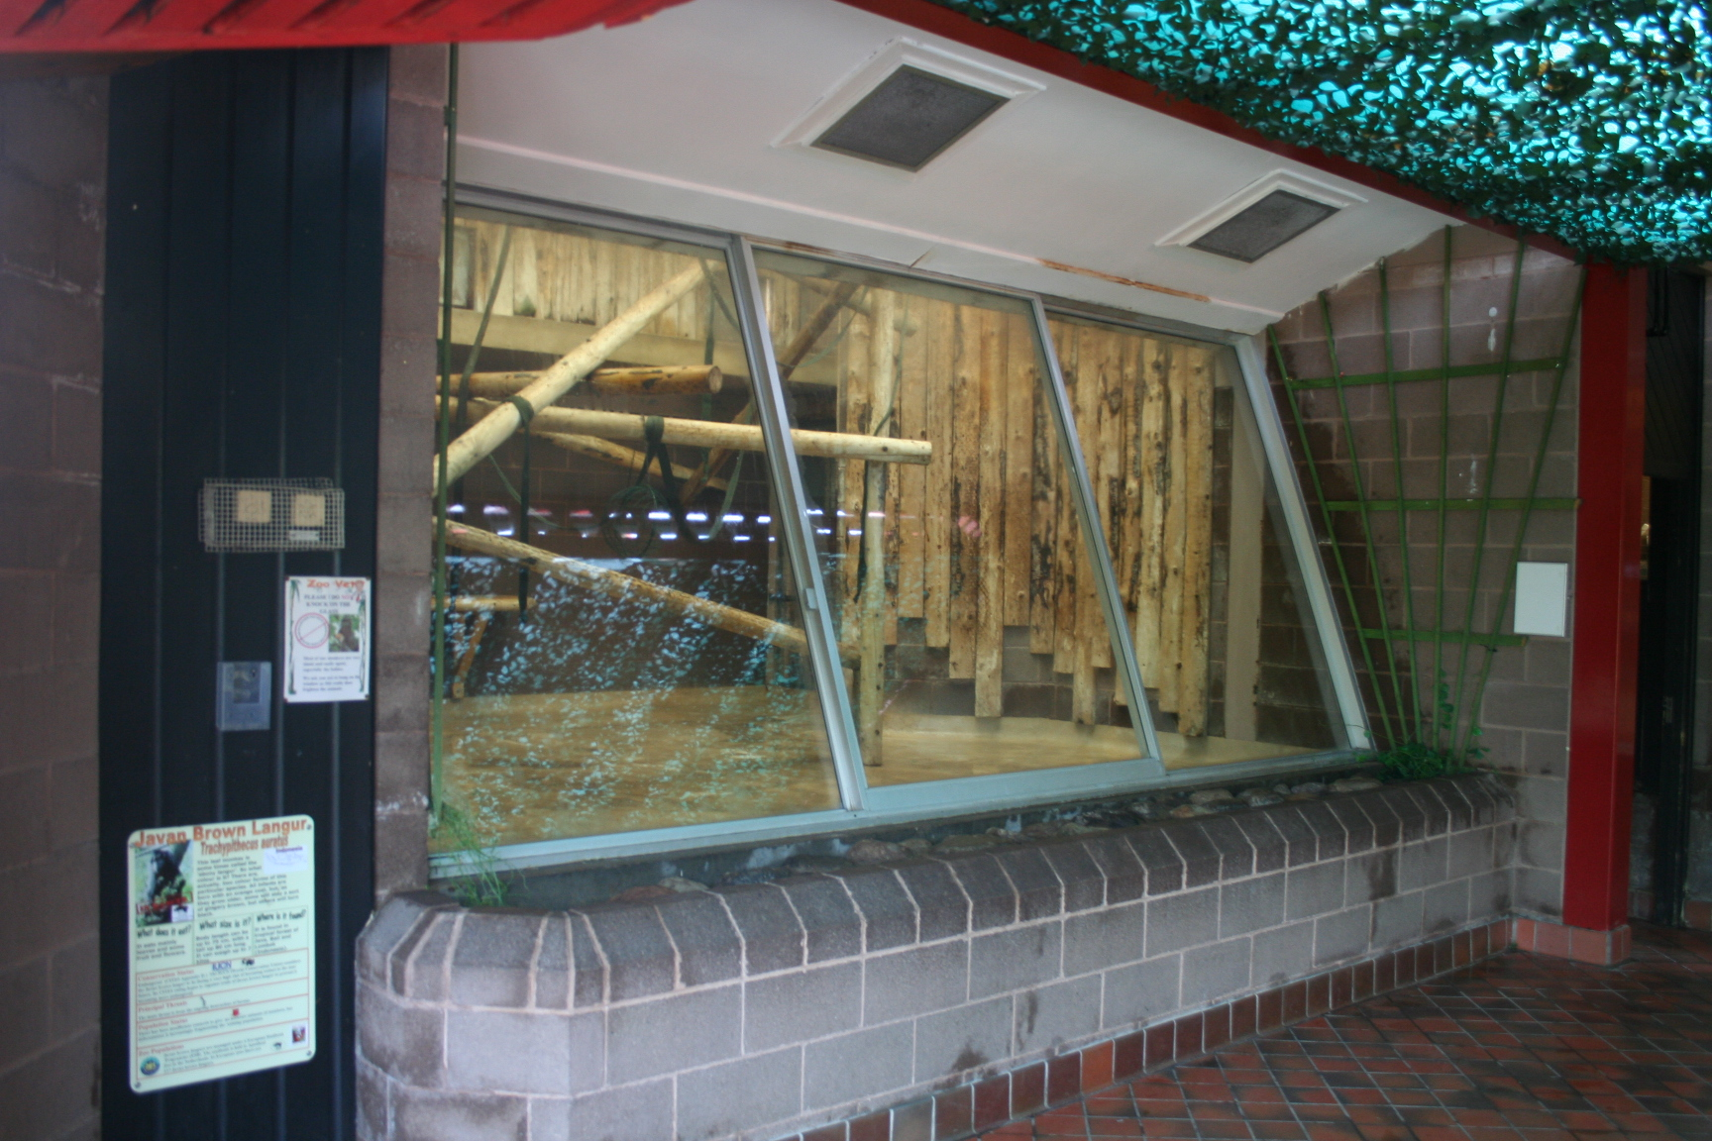
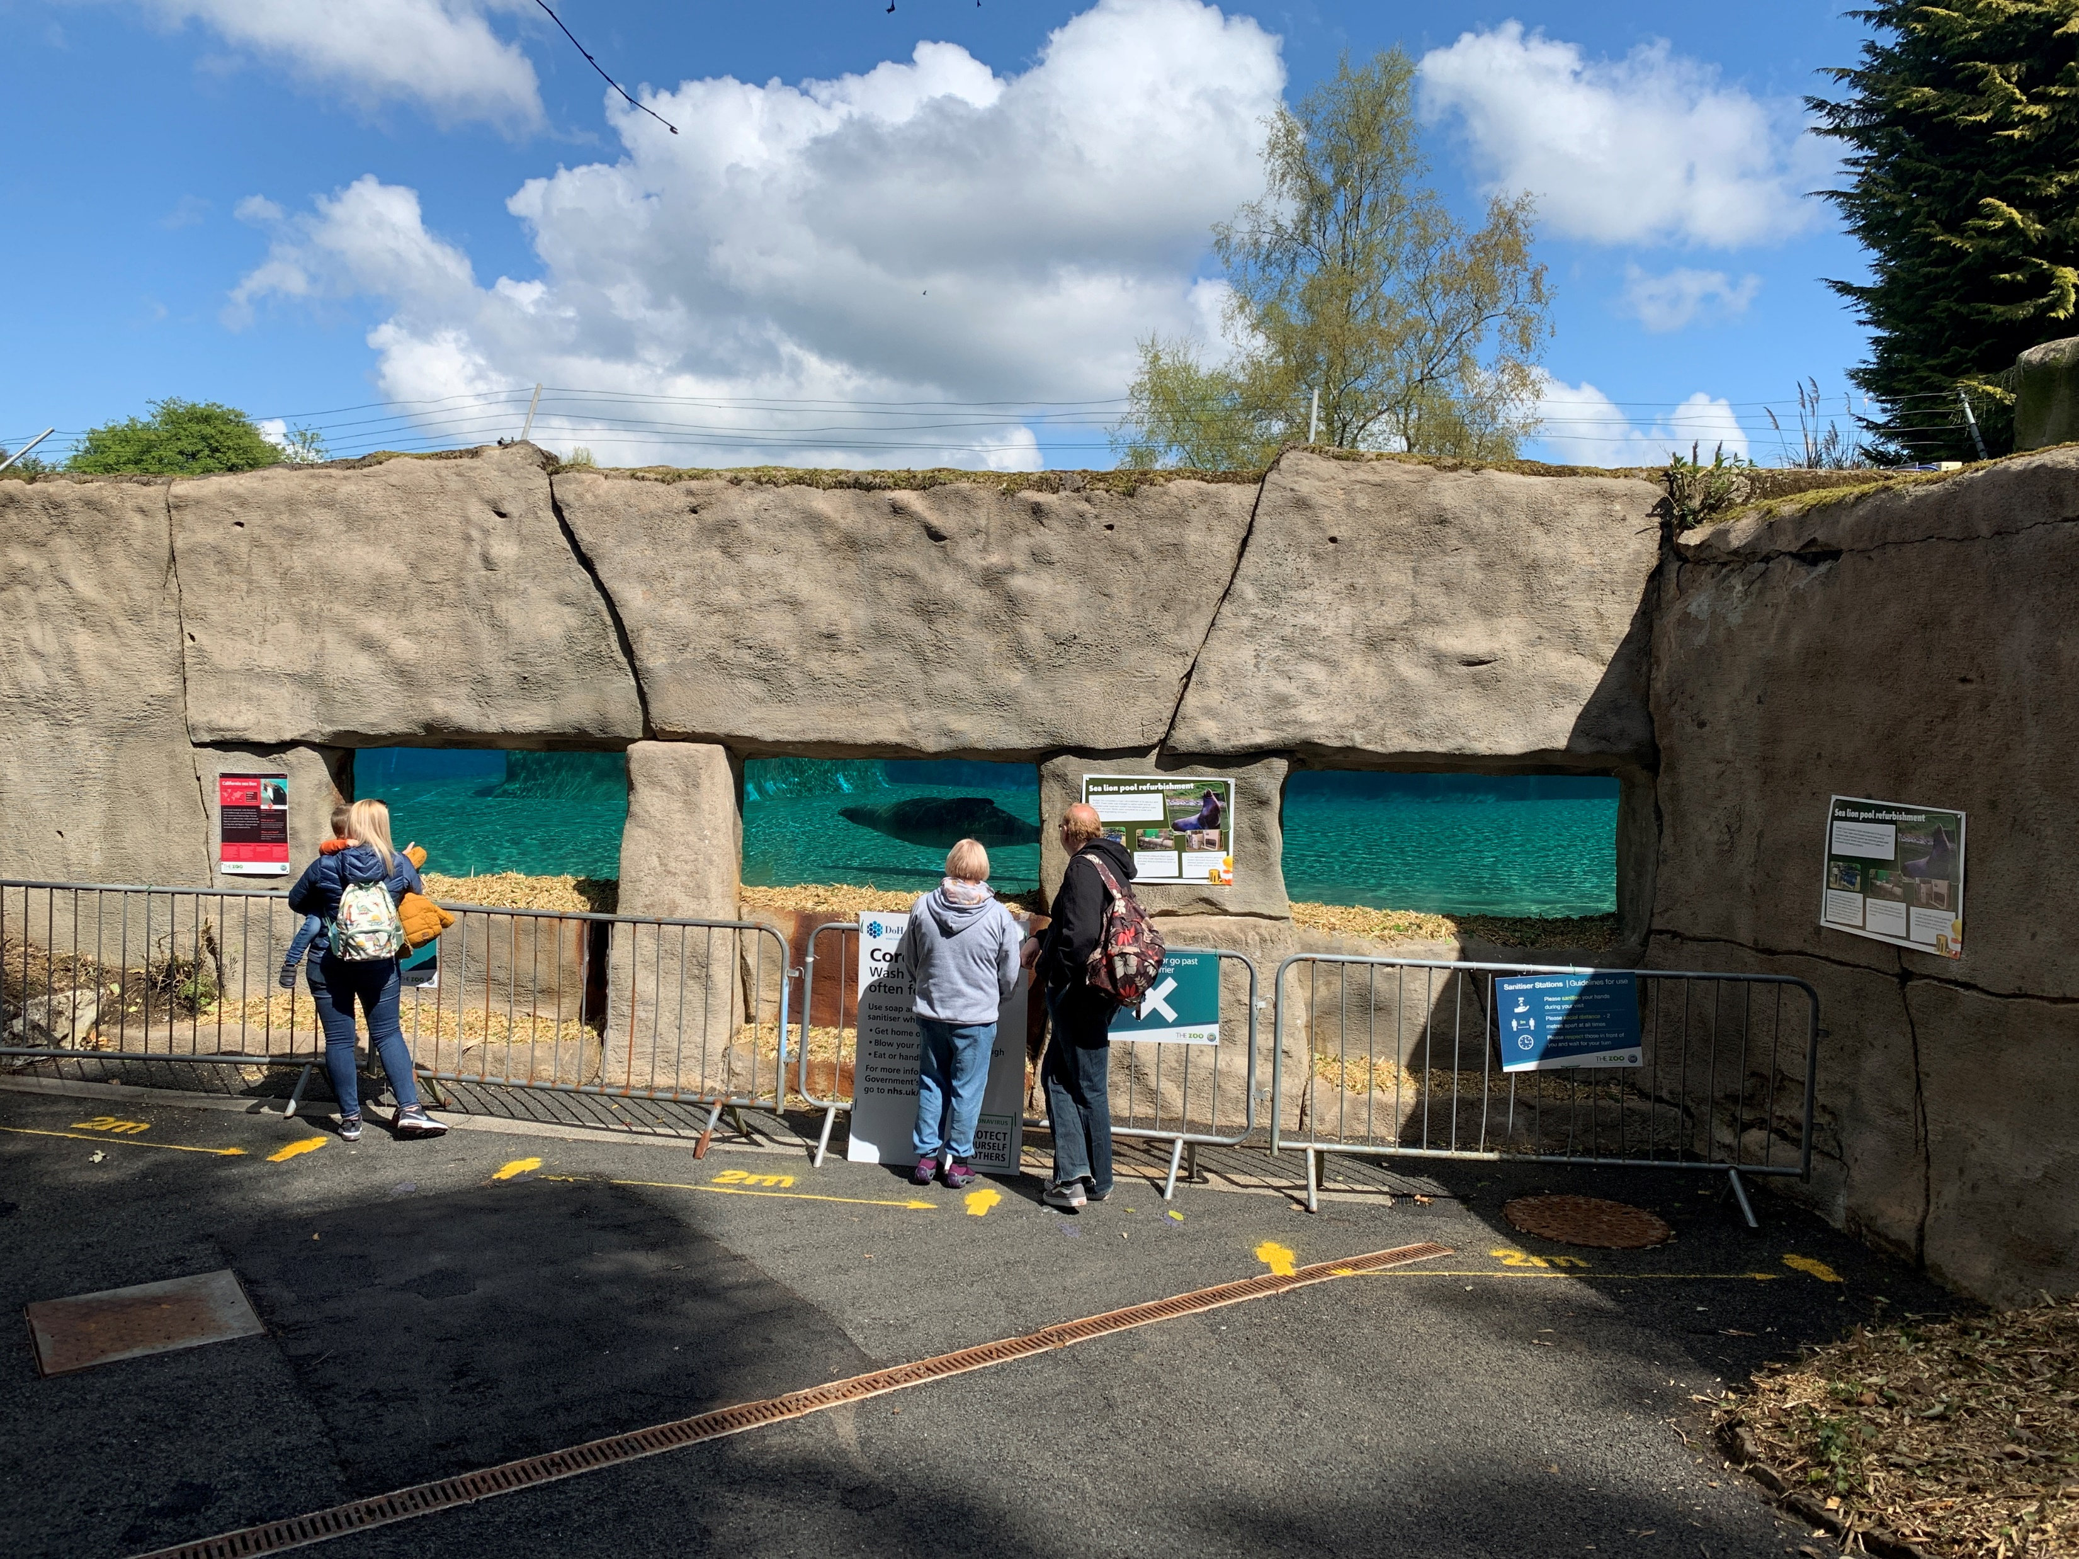
All the animals are up the big hill, some may be inside, and some may be outside.

Slide 11
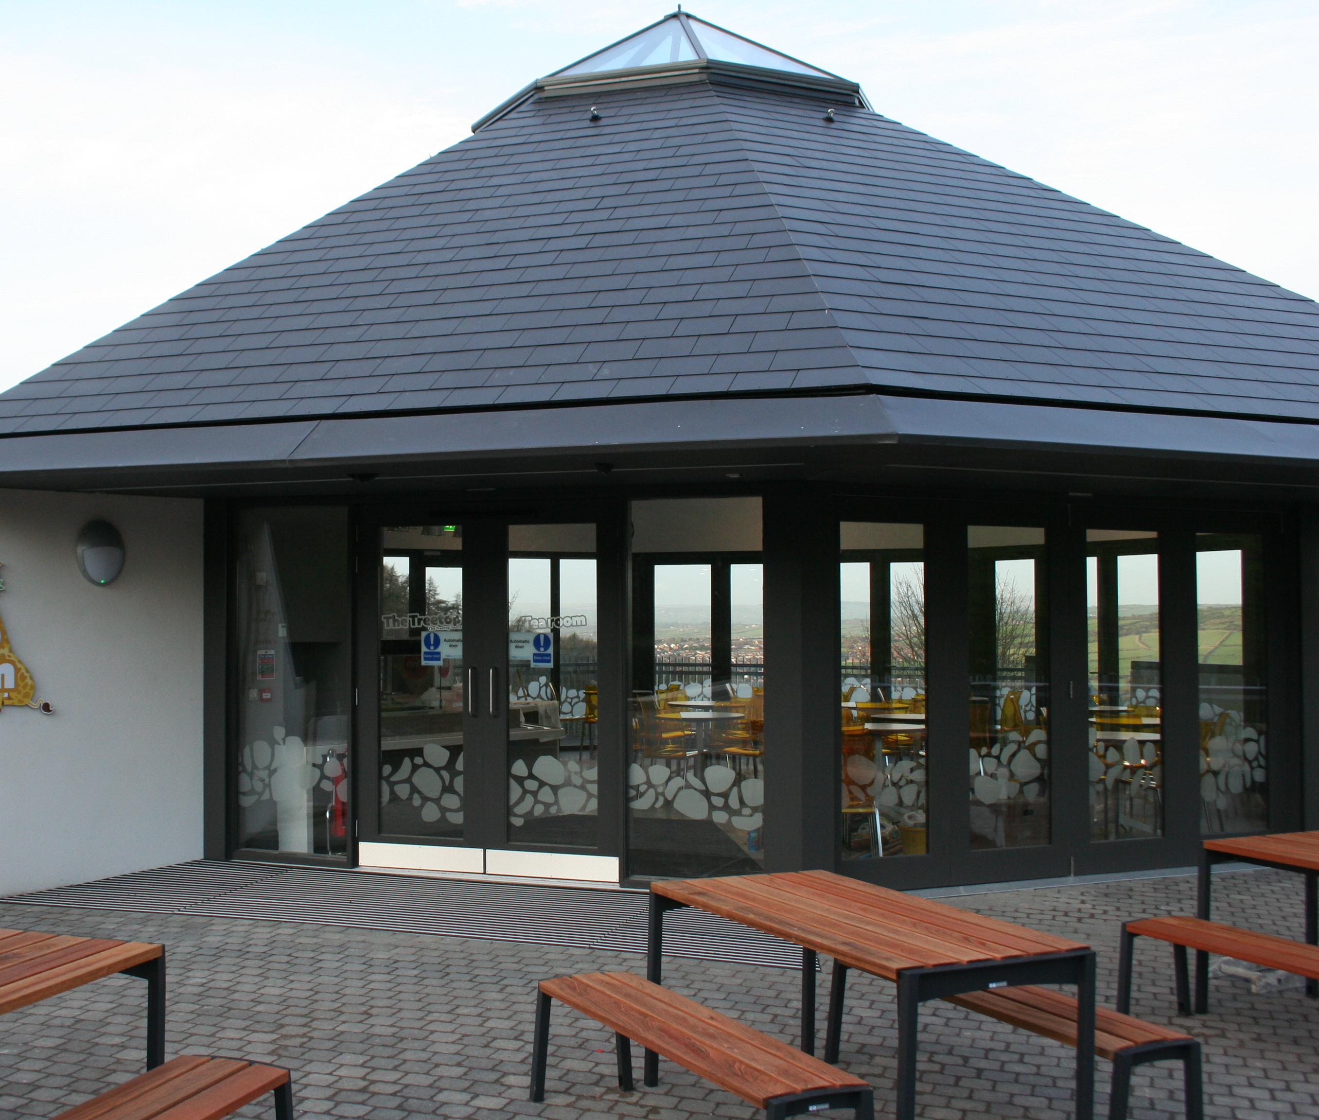
At the top there is a café called Tree top where we can have our lunch on picnic benches.

Slide 12
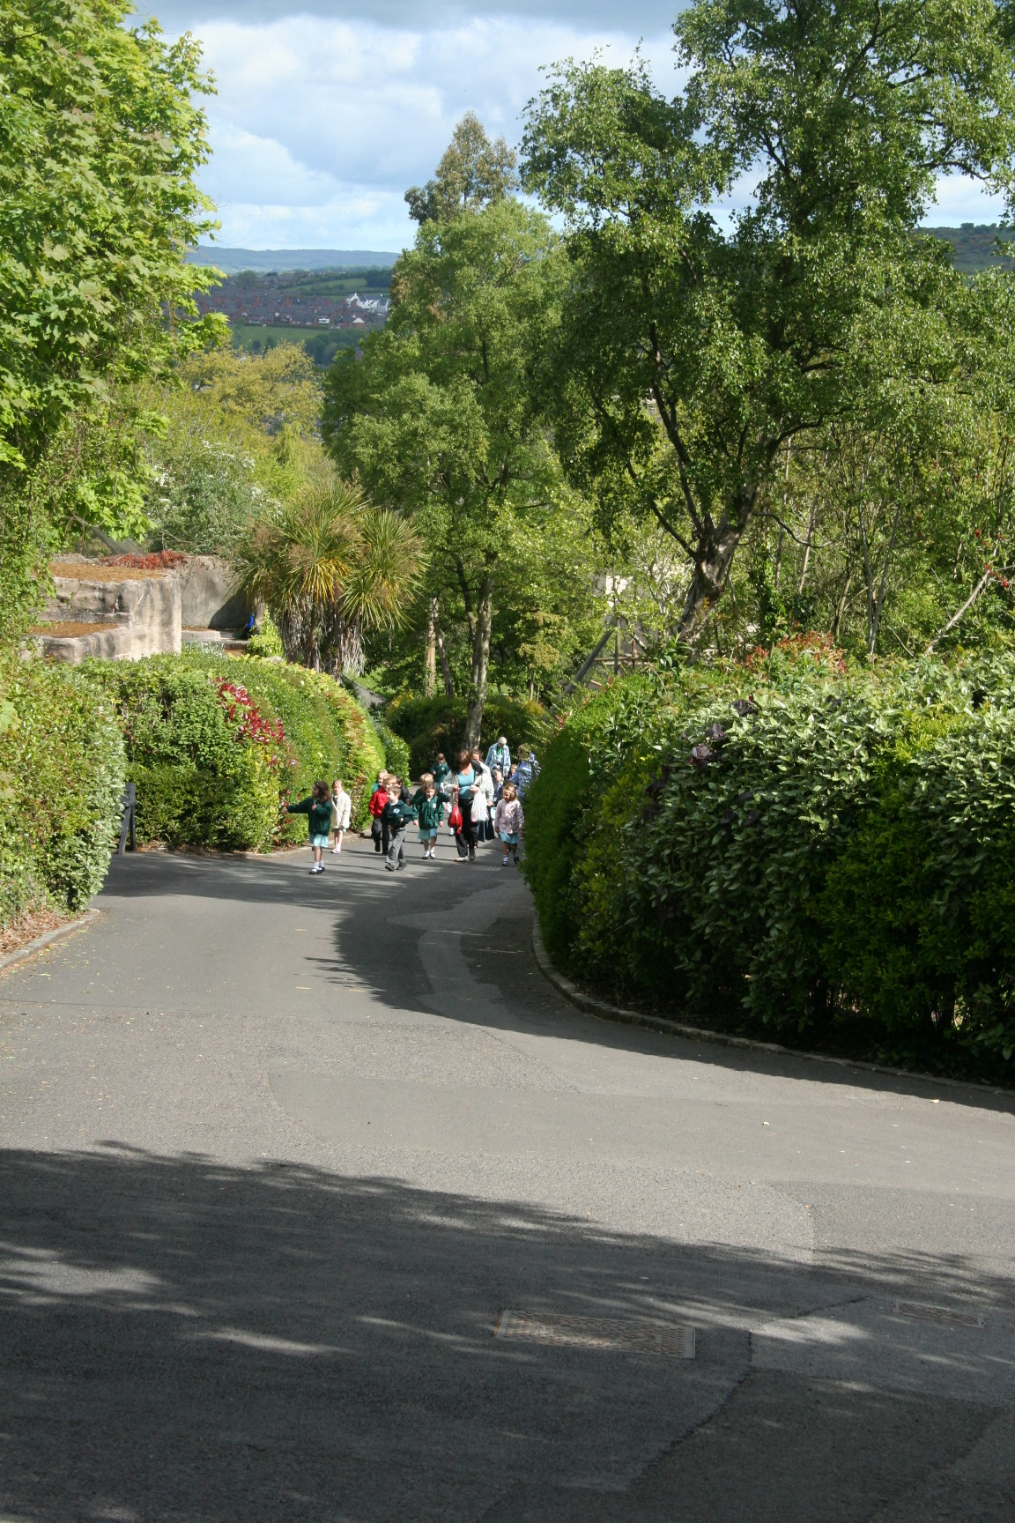
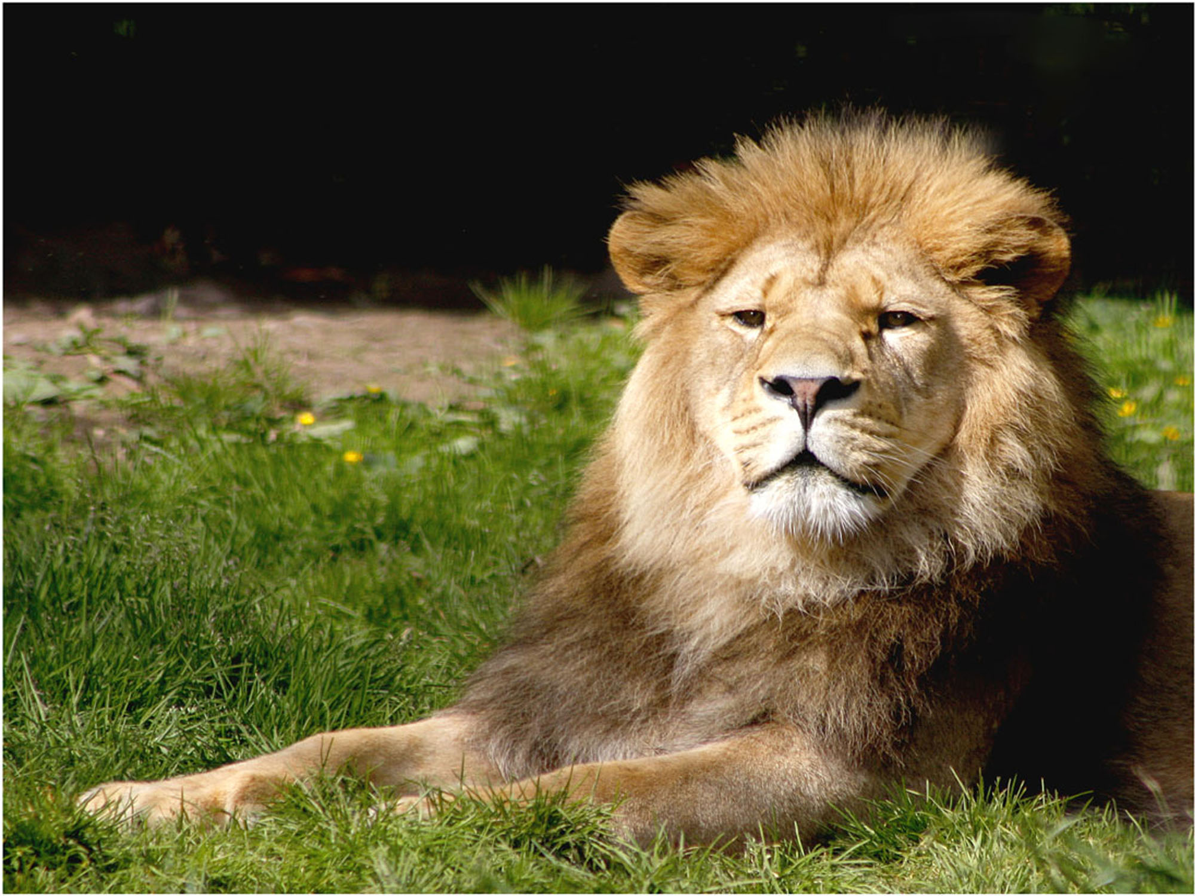
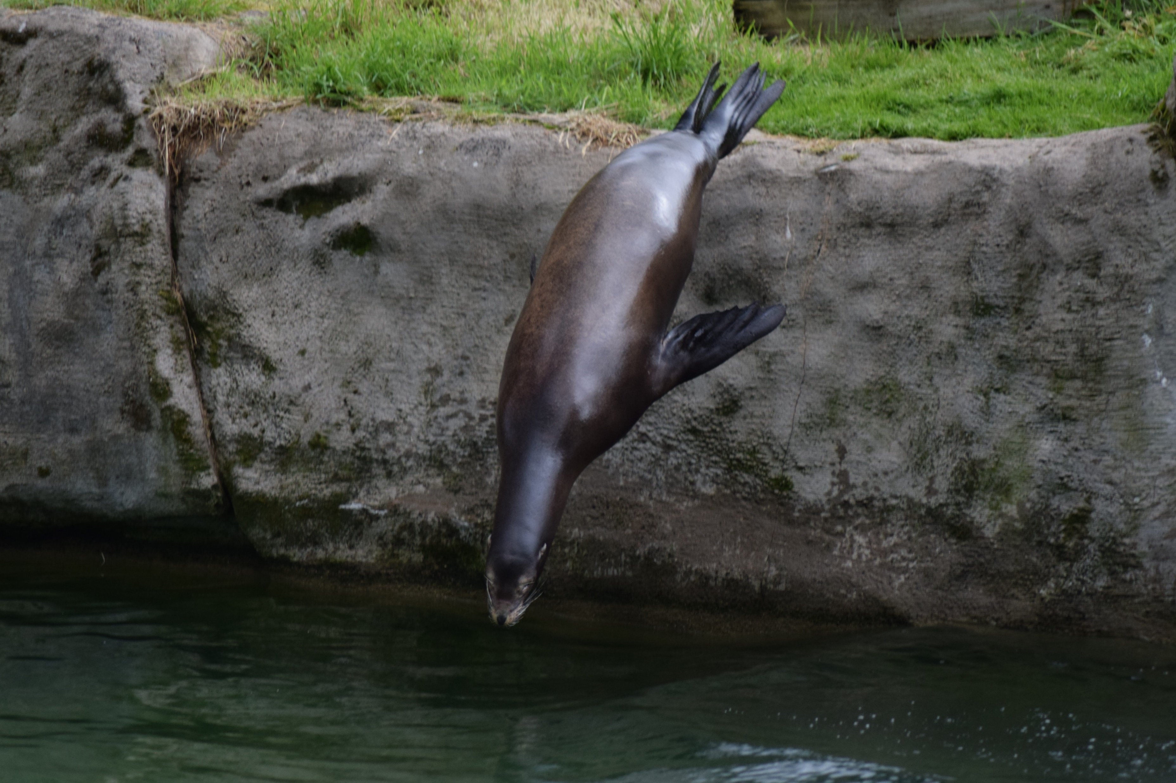
Down the hill there will be lots more animals for us to see.

Slide 13
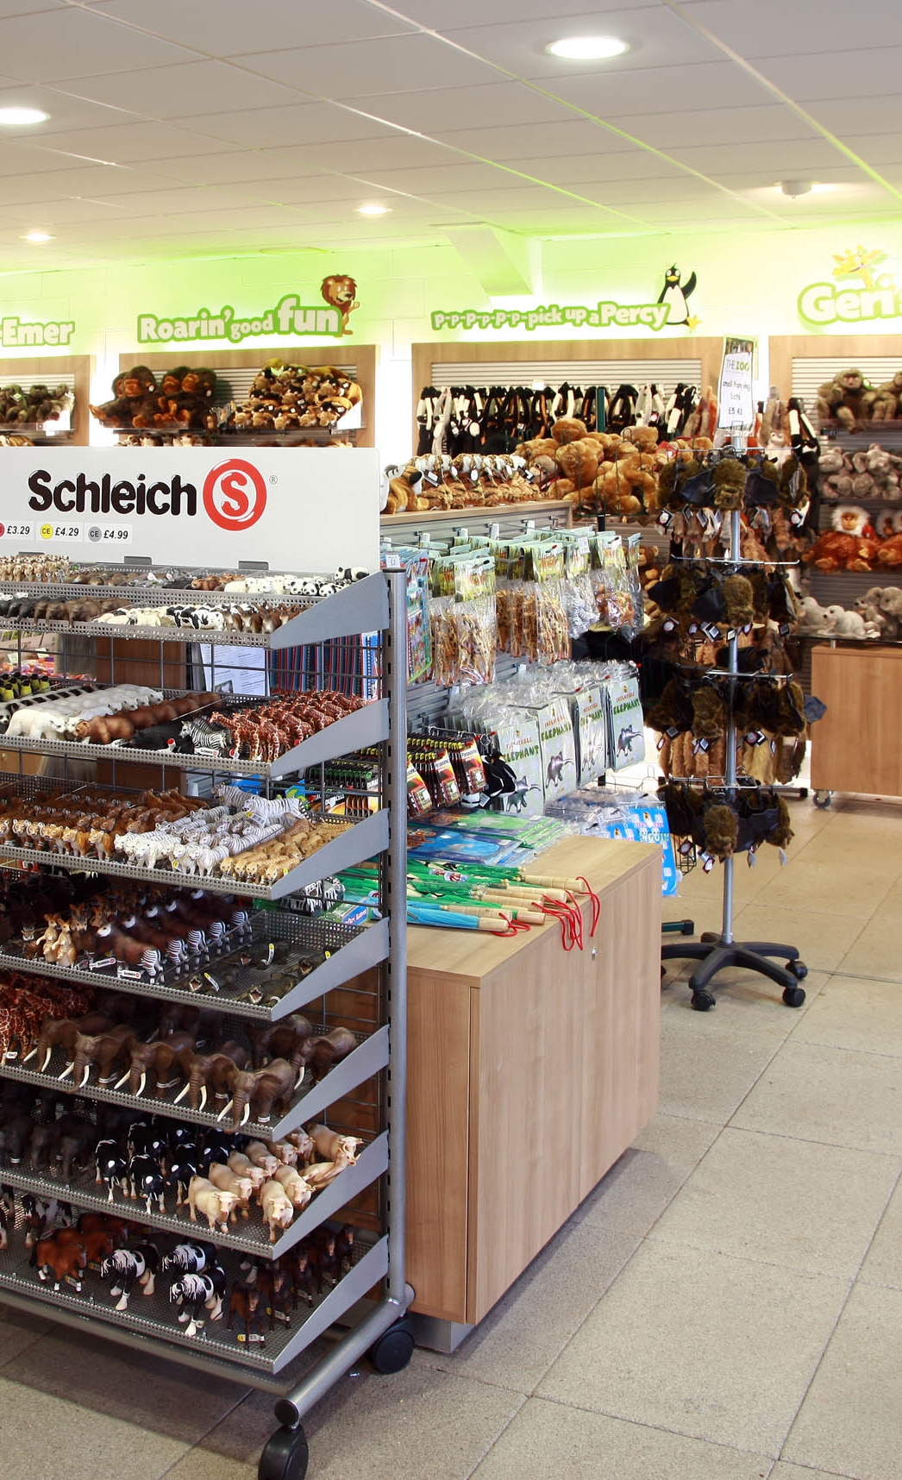
When it’s time to go home we leave through the giftshop

Slide 14
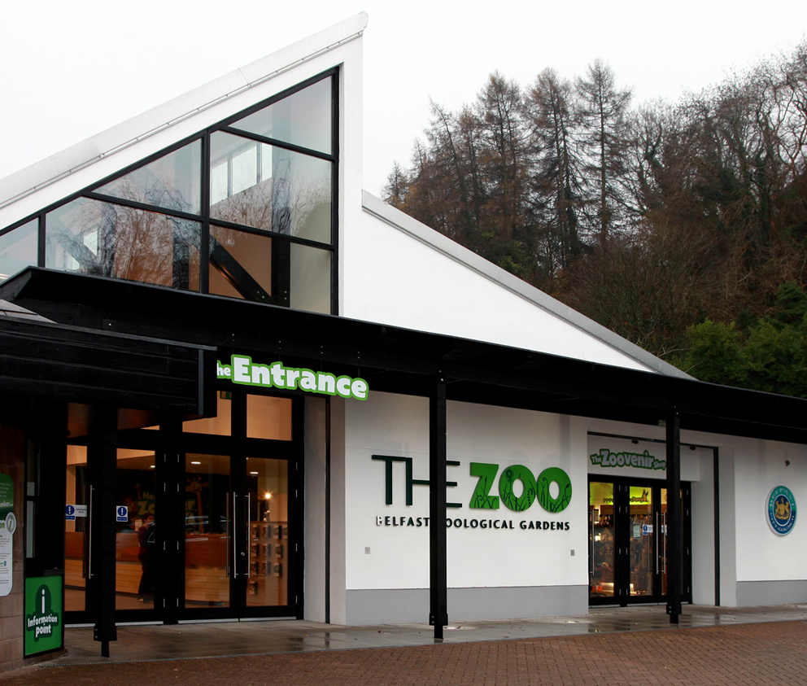
Then we say goodbye to the zoo and head back to school on the bus.

